Slide 1
REPORT
TumorTrace: MRI-Based AI for Breast Cancer Detection
J RAKSHA

Slide 2
Breast cancer is the most common cancer among women and a leading cause of cancer-related deaths. Early and accurate diagnosis is critical for better outcomes, but traditional methods like mammography, ultrasound, and MRI depend on radiologists and may lead to subjective errors.
AI advancements, particularly convolutional neural networks (CNNs), offer a way to enhance diagnostic accuracy by identifying patterns beyond human perception. MRI imaging is highly effective due to its superior soft tissue visualization but remains challenging to interpret.
We propose TumorTrace, a hybrid AI framework that combines traditional techniques like HOG, LBP, and GLCM with deep learning models (VGG16 ,ResNet18 and ResNet20 ) to classify breast tumors as benign or malignant. This approach balances high accuracy with interpretability, aiming for robust performance across diverse datasets.
.

Slide 3
AGENDA
DATASET
DATASET PREPARATION
FEATURE EXTRACTION
MODEL DEVELOPMENT
TRAINING AND VALIDATION
MODEL EVALUATION
DEPLOYMENT AND SCALABILITY

Slide 4
DATASET
Dataset Structure:
Organized into train, validation, and test sets with 29,274 images across 4,185 folders.
Train: 5,559 Benign, 14,875 Malignant
Validation: 408 Benign, 1,581 Malignant
Test: 1,938 Benign, 4,913 Malignant

Slide 5
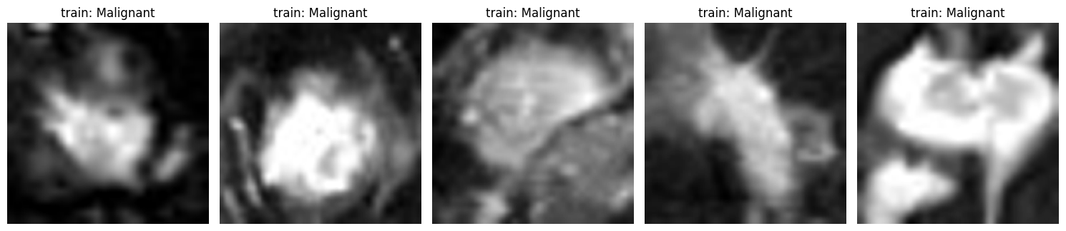
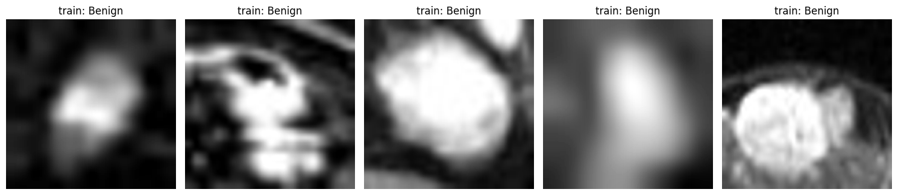

Slide 6
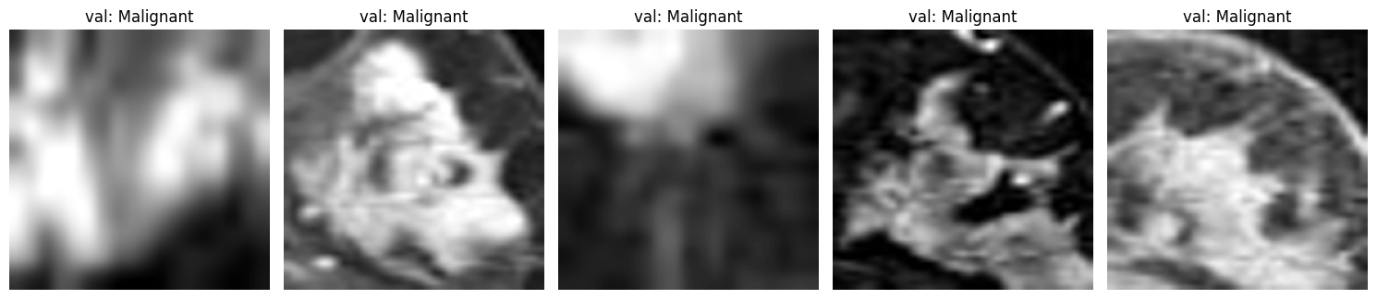
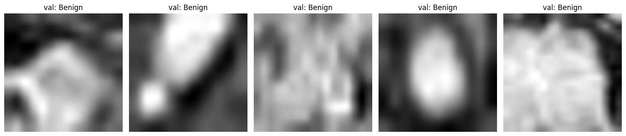

Slide 7
DATASET PREPARATION
Image Resizing: All MRI images resized to 224x224 pixels for compatibility with deep learning models (e.g., VGG16, ResNet). Ensures uniformity and efficient batch processing.
Data Augmentation: Techniques applied to improve generalization and mitigate overfitting:
Flips: Horizontal and vertical flips simulate tumor orientations.
Rotation: ±30° rotations for angle variations.
Shear: Affine shear mimics irregularities in MRI scans.
Color Jitter: Adjusts brightness, contrast, saturation, and hue to account for variability in imaging conditions.
Data Split and Loading:
Organized into train, validation, and test sets.
PyTorch DataLoaders handle batching (batch size = 32), shuffling (training), and normalization (pixel values scaled to [-1, 1]).
Validation and test sets are non-shuffled for consistent evaluation.
This pipeline ensures robust, diverse data preparation, enabling the model to confidently classify benign and malignant tumors.

Slide 8
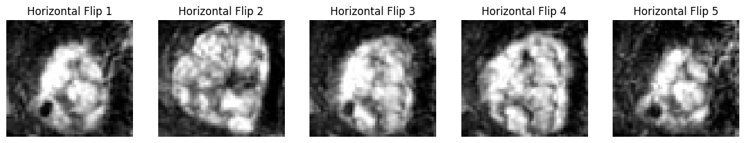
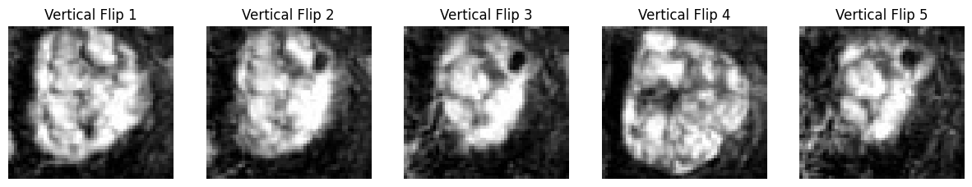
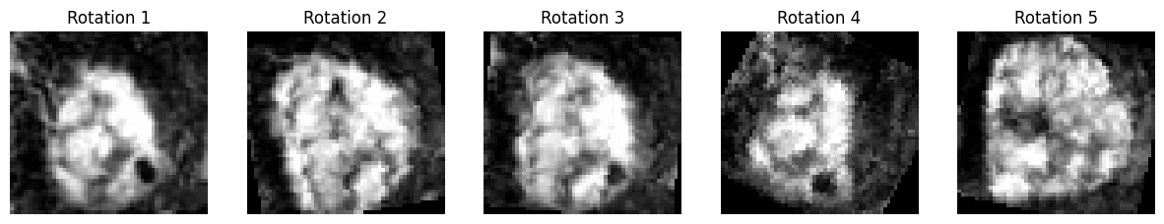

Slide 9
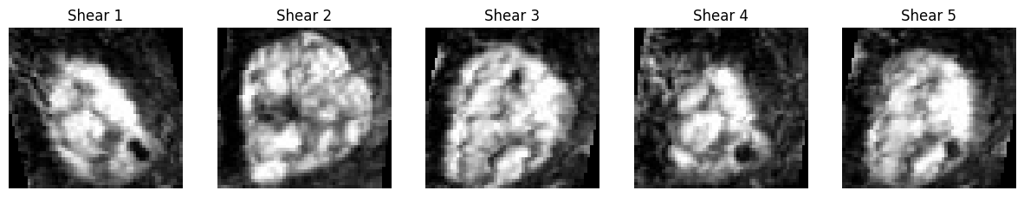
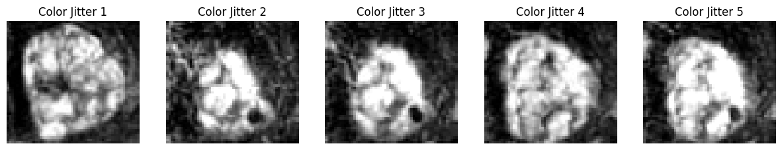

Slide 10
FEATURE EXTRACTION
Extract meaningful patterns like edges, textures, and spatial relationships from MRI images.
Critical for distinguishing benign from malignant tumors.
Combines handcrafted techniques and deep learning for comprehensive analysis.

Slide 11
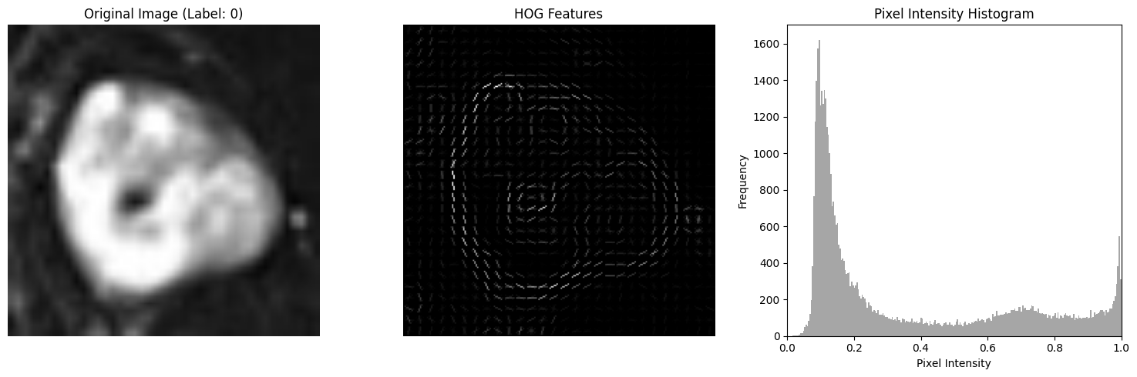
HISTOGRAM OF ORIENTED GRADIENTS (HOG)
Captures gradient direction distribution in localized image regions.
Highlights edges and contours to identify tumor boundaries and shapes.

Slide 12
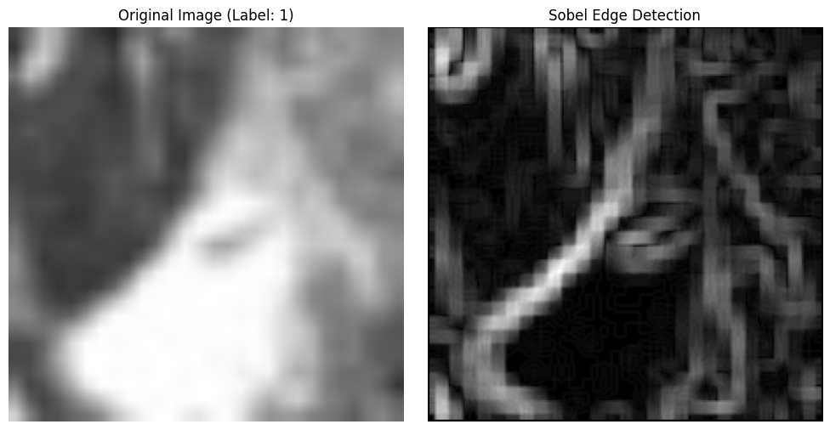
Sobel Edge Detection
Detects sharp intensity changes to accentuate tumor boundaries.
Effective for visualizing irregularities in malignant tumors.

Slide 13
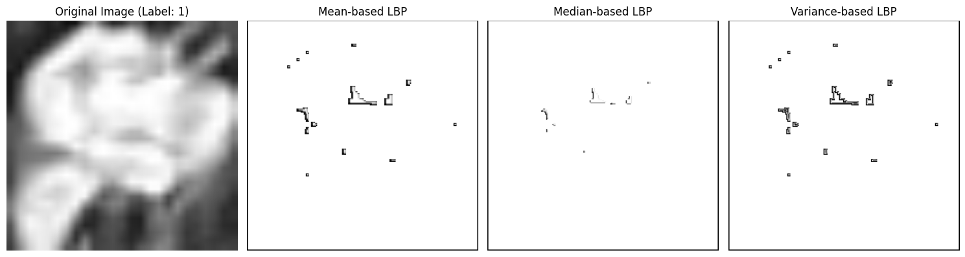
LOCAL BINARY PATTERNS (LBP)
Encodes local texture variations into binary patterns.
Statistical Descriptors:
Mean: Reflects overall texture intensity (complex for malignant, smooth for benign).
Median: Highlights dominant patterns, robust to outliers.
Variance: Measures texture variability, identifying irregularities in malignant tumors.

Slide 14
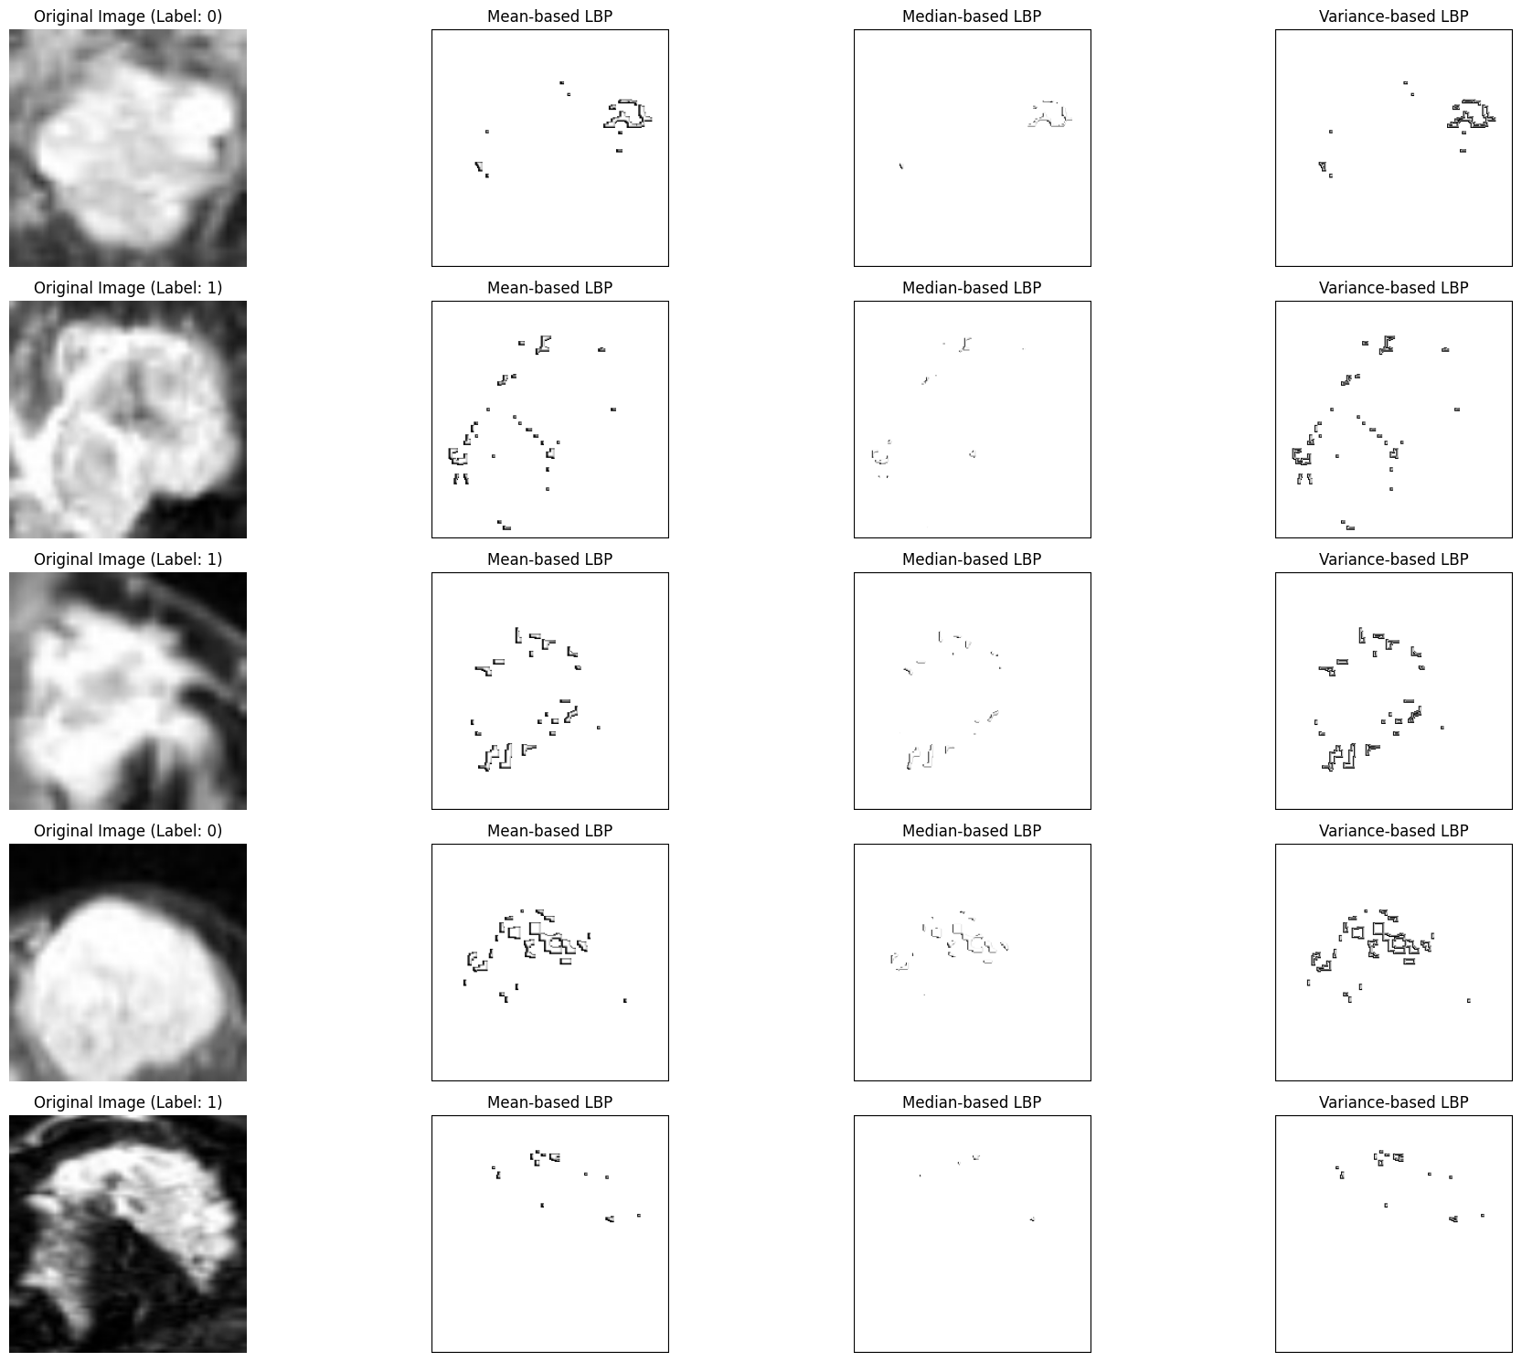

Slide 15
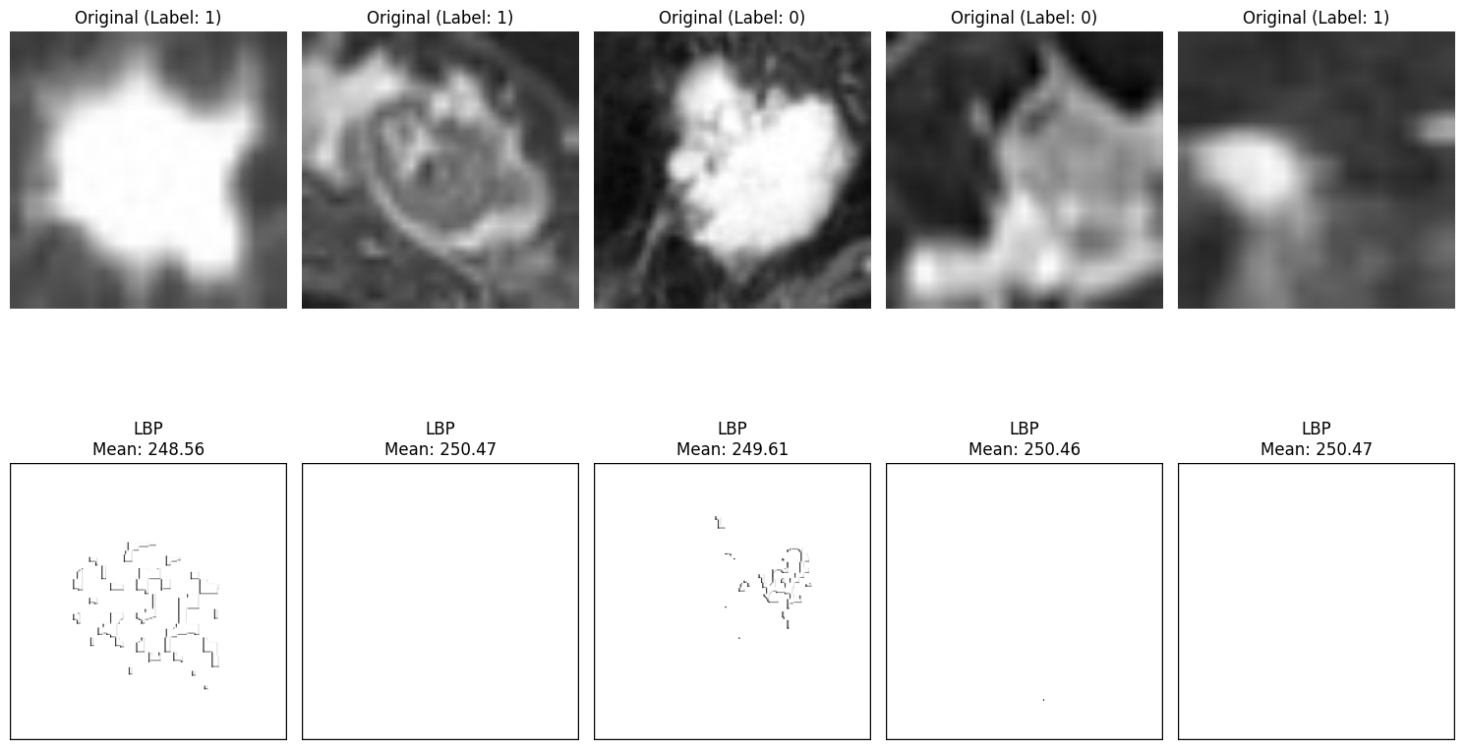
LBP MEAN

Slide 16
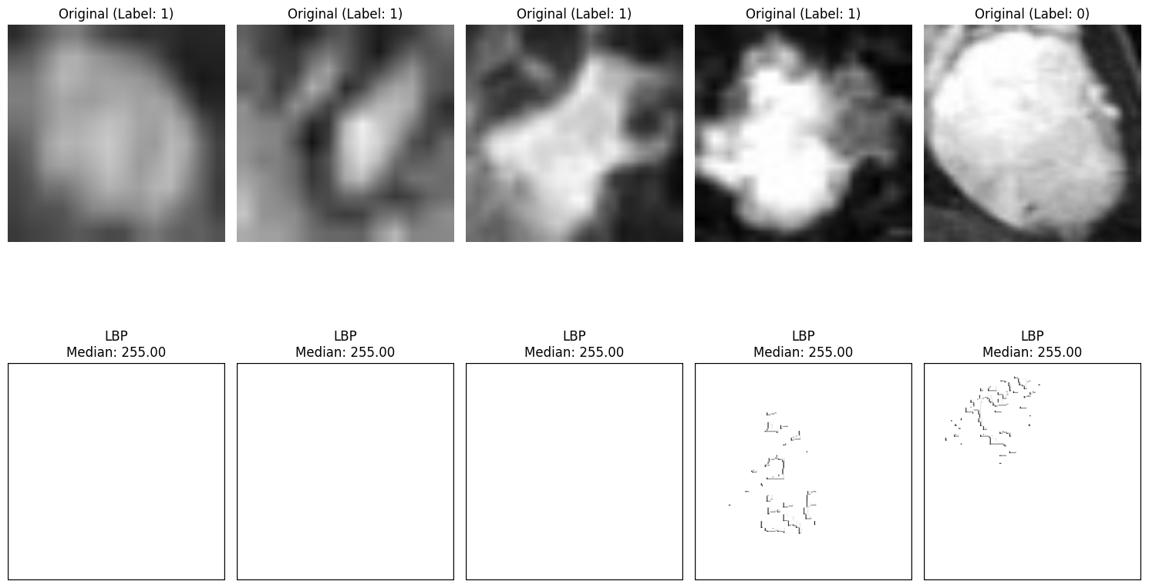
LBP MEDIAN

Slide 17
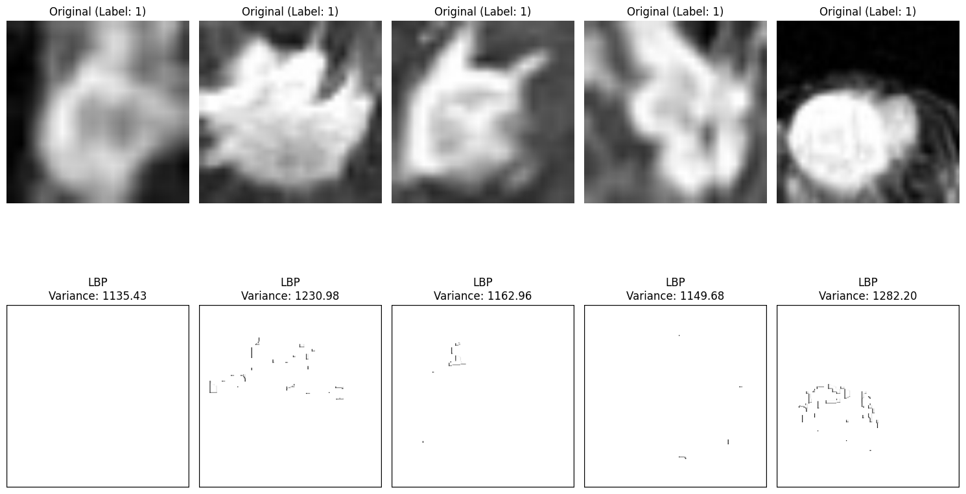
LBP VARIANCE

Slide 18
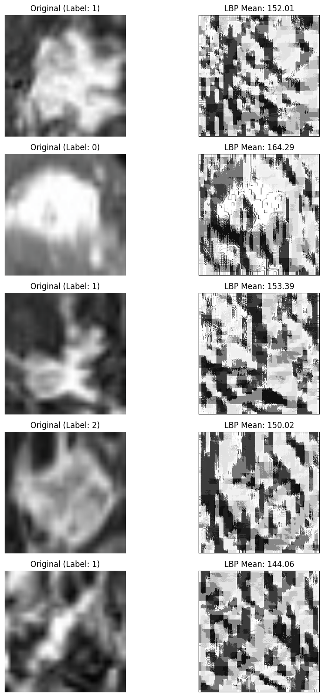
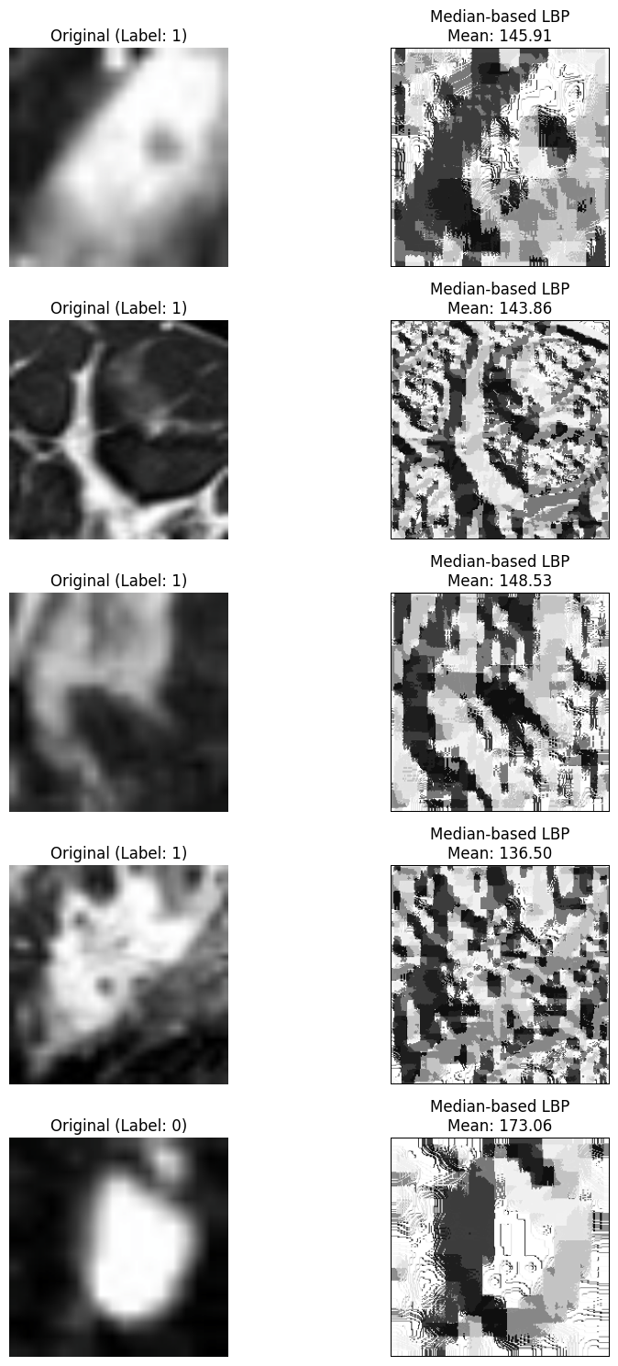
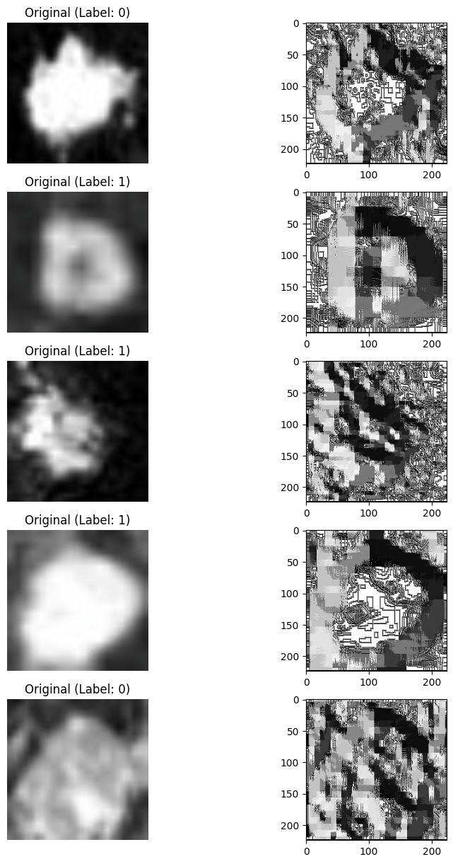

Slide 19
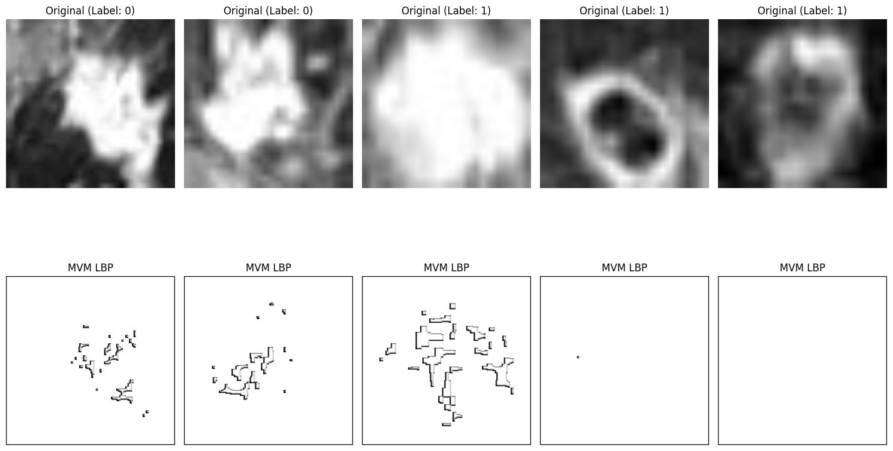
MVM LBP

Slide 20
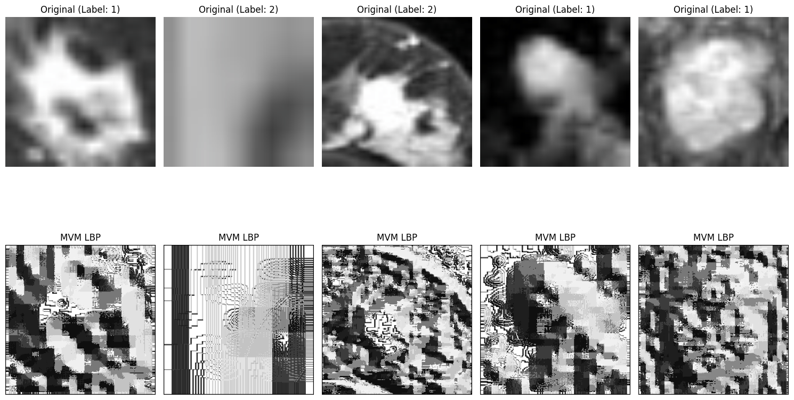
MVM LBP

Slide 21
GRAY LEVEL CO-OCCURRENCE MATRIX (GLCM)
Analyzes spatial relationships of pixel intensities.
Extracts texture features:
Contrast: Intensity differences between pixels.
Correlation: Relationship between pixel values.
Energy: Texture uniformity.
Homogeneity: Similarity of neighboring pixel values.

Slide 22
MODEL DEVELOPMENT
Model Architecture
Fine-tuned pre-trained deep learning models: VGG16, ResNet18, ResNet50.
Custom layers added for binary classification (Benign vs. Malignant).
Optimization
Optimizer: Adam optimizer ensures adaptive and efficient weight updates.
Loss Function: Binary Cross-Entropy for precise calculation of classification errors.
Training Strategy
Learning Rate Scheduler: Dynamically adjusts learning rate for faster convergence and improved performance.

Slide 23
TRAINING AND VALIDATION
Training Approach
Models trained over multiple epochs with continuous validation to monitor performance.
Metrics Monitored:
Accuracy
Precision
Recall
F1-Score
AUC (Area Under the Curve)
Regularization Techniques:
Early stopping to prevent overfitting.
Dropout for enhanced generalization.

Slide 24
MODEL PERFORMANCE
VGG16:
Training Accuracy: 99.97%.
Validation Accuracy: 83.56%–83.86%.
AUC: Best recorded AUC was 0.9037.
ResNet18:
Training Accuracy: 100%.
Validation Accuracy: ~83.6%.
AUC: Stable but slightly lower compared to other models.
ResNet50:
Training Accuracy: 100%.
Validation Accuracy: 83.11%–84.21%.
AUC: 0.9298 (highest among all models).

Slide 25
TRAINING AND VALIDATION
ResNet50 emerged as the best-performing model with the highest AUC (0.9298), indicating superior generalization capabilities.
Saved the best-performing models for further analysis and deployment.

Slide 26
MODEL EVALUATION
The trained models were assessed on a separate test dataset consisting of 1,938 Benign and 4,913 Malignant images, focusing on key metrics such as sensitivity, specificity, precision, recall, F1-score, and ROC-AUC.

Slide 27
VGG16 MODEL
Test Accuracy: 74.27%
Test Loss: 1.2546
Test AUC: 0.8226
Performance Insights: Moderate accuracy and AUC, indicating room for improvement in detecting both benign and malignant tumors

Slide 28
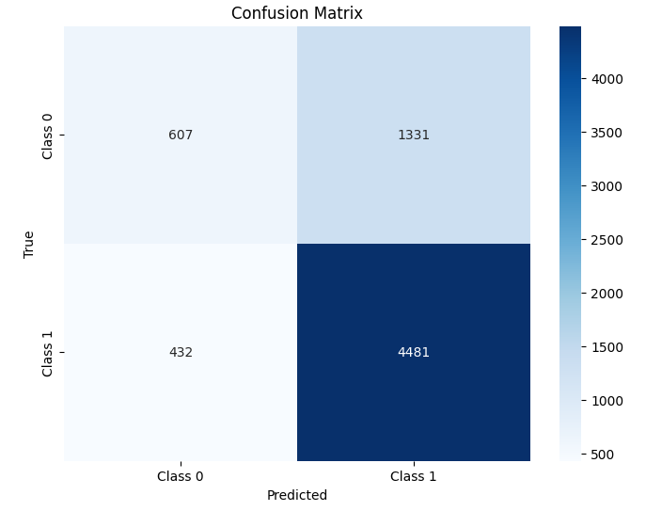
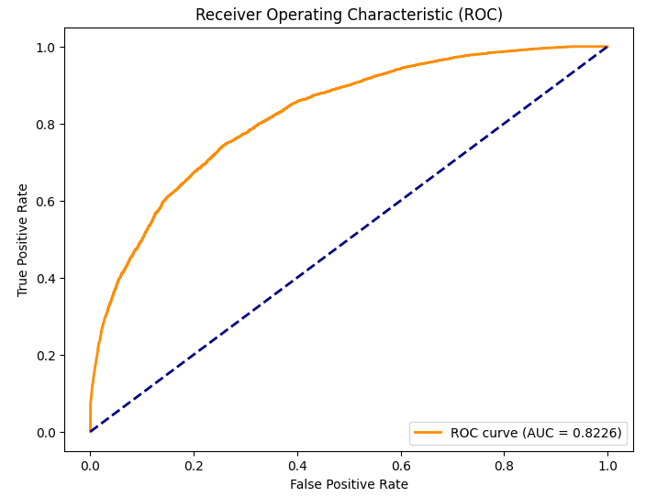

Slide 29
ResNet18 Model
Test Accuracy: 74.34%
Test Loss: 1.1192
Test AUC: 0.8345
Performance Insights: Improved accuracy and AUC over VGG16, but still struggles with a high number of false positives, indicating difficulty in distinguishing benign cases.

Slide 30
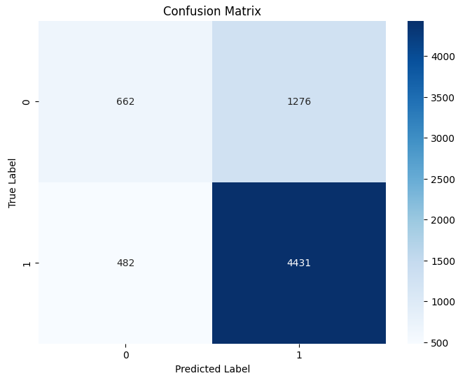
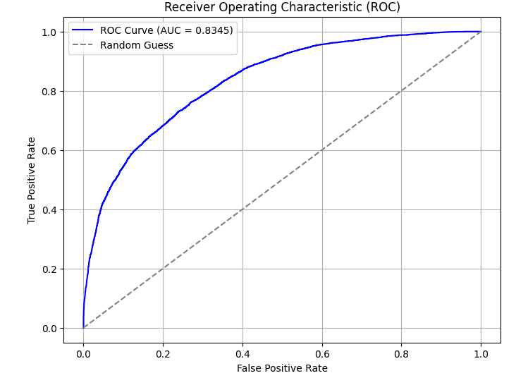

Slide 31
RESNET50 MODEL
Test Accuracy: 77.54%
Test Loss: 4439.4057
Test AUC: 0.8549
Performance Insights: Achieved the highest accuracy and AUC, with improved generalization to the test dataset. However, false negatives and false positives remain, indicating further room for improvement.

Slide 32
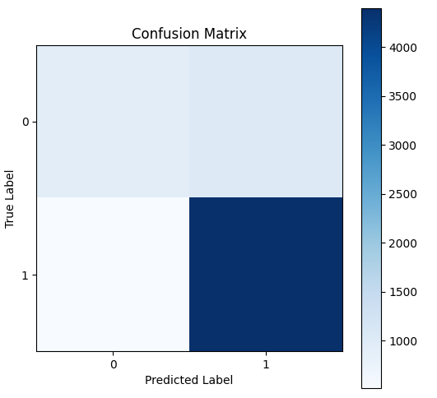
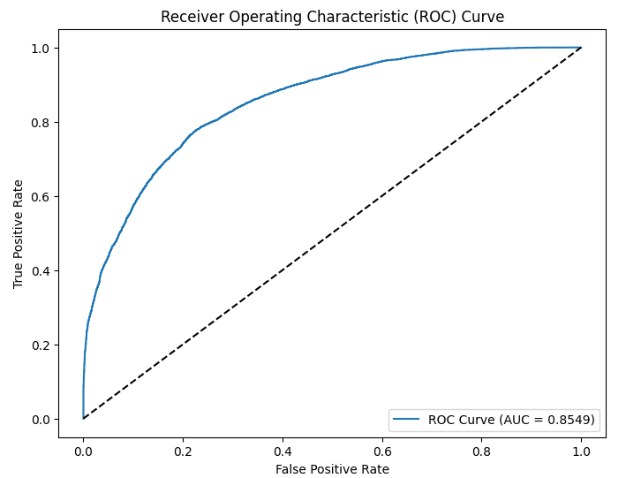

Slide 33
DEPLOYMENT AND SCALABILITY
The final model is designed for deployment in clinical settings to enable real-time classification of breast tumor MRI scans, ensuring quick and efficient diagnosis in healthcare environments.
Model: ResNet50 (fine-tuned for binary classification of Benign vs. Malignant tumors)..
Scalable: The deployment ensures the system can handle multiple requests simultaneously, making it suitable for clinical environments.
Optimized for GPUs: The model is adapted to run efficiently on modern GPUs, enabling fast processing of MRI images for rapid diagnosis

Slide 34
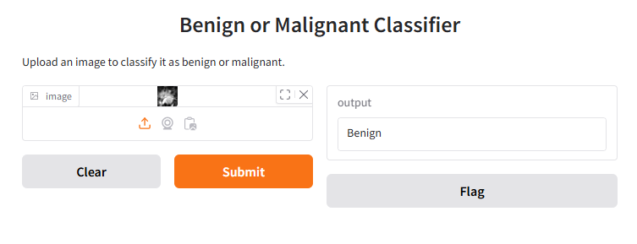
USER INTERFACE
Gradio Interface: Provides an easy-to-use web application where users can upload MRI scan images for real-time predictions.
Image Processing: Images are resized to 224x224 pixels and normalized using ImageNet statistics to ensure compatibility with the ResNet50 model.

Slide 35
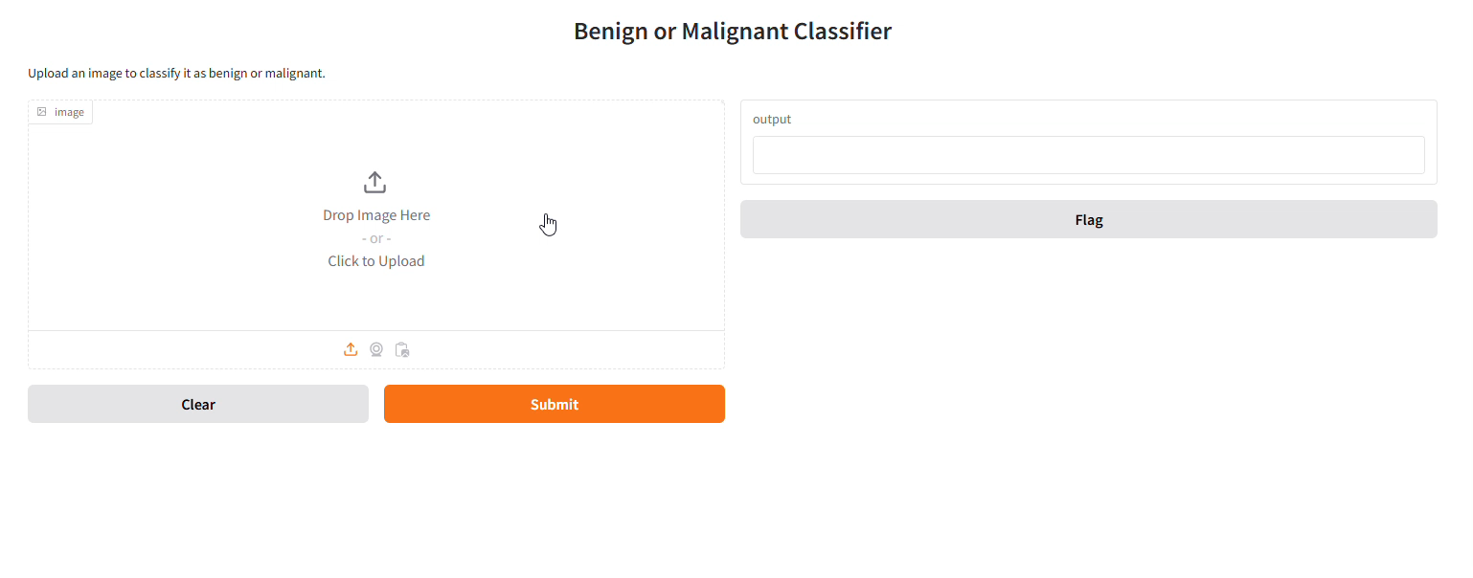
USER INTERFACE

Slide 36
Thank you!

